Slide 1
Measurements of dose point kernels using GATE Monte Carlo toolkit for personalized convolution dosimetry
Ashok Tiwari^{1,2}, Stephen A. Graves³, John Sunderland^{1,2}
¹Department of Radiology, University of Iowa Hospitals and Clinics, IA
²Department of Physics, University of Iowa, Iowa City, IA
³Department of Radiation Oncology, University of Iowa Hospitals and Clinics, IA
SNMMI Annual Meeting, Anaheim, CA
June 24, 2019

Slide 2
Outline
Introduction
Objectives
Methodologies
Results
Conclusion
Notes:
Here is the brief outline of the talk.

Slide 3
Introduction
Dose Point Kernels (DPKs):
are defined as energy deposition profiles from a point isotropic sources
method to compute the absorbed dose from the non-uniform activity or high gradient activity distributions
Usefulness of kernels?
Convolution dosimetry: calculate the dose distributions using the convolution of 3D-dose kernel matrix with cumulated activity map furnished by quantitative SPECT/CT or PET/CT images.
Cumulated activity is represented by area under the time activity curve
Ultimate goal: patient-specific dosimetry
Notes:
Let me introduce the dose point kernels.

Slide 4
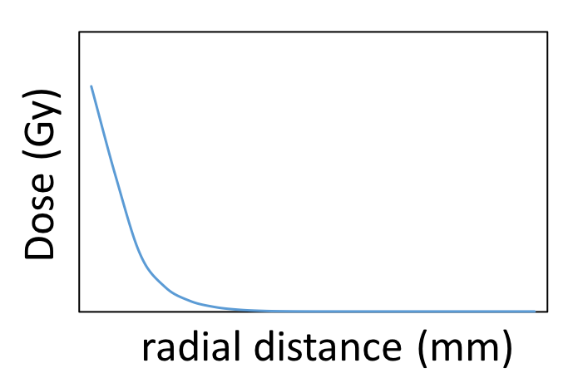
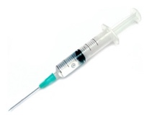
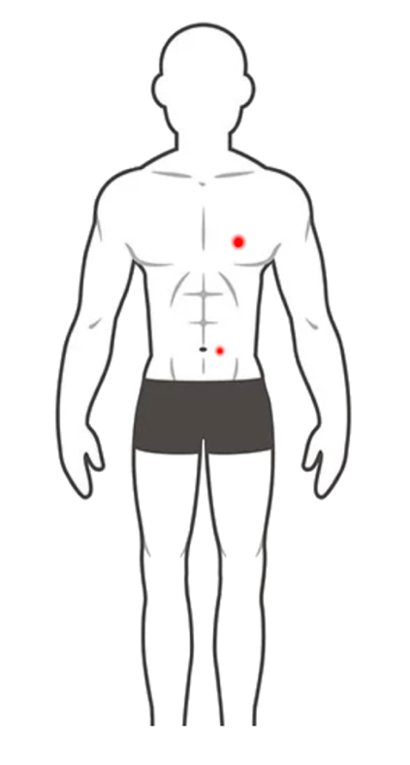
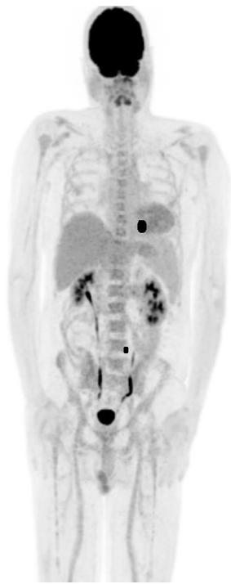
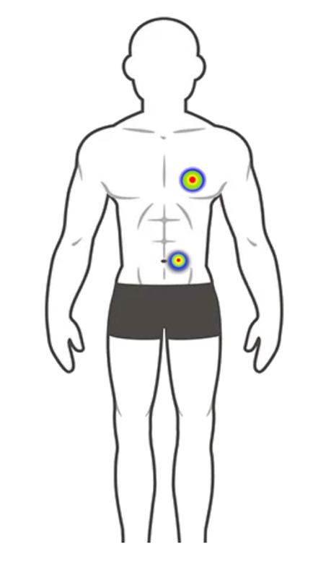
Patient-specific dosimetry:
Extract activity map/matrix
inject radio-pharmaceuticals
Convolution/Superposition:
cumulated activity ⊗ dose point kernels
patient
PET/CT or SPECT/CT scan
measurement of absorbed dose
Figure: Schematic representation of the workflow for the patient-specific dosimetry using the Monte Carlo generated dose point kernels and the patient PET/CT scan.
Because of its complex nature it has not been implemented in clinical settings yet!
Notes:
Activity map/matrix is patient specific.
Dose point kernels are physics related and beta radionuclides specific.

Slide 5
Monte Carlo approaches to generate dose point kernels
approx. solution of transport equations, no exact/non-trivial analytic solutions
simulation of stochastic process (e⁻ s and γ-s transport)
Geant4, GATE, EGS, FLUKA, PENELOPE, ETRAN, MCNP, SMOOPY etc.
GATE: Geant4 Application for Tomographic Emission
GATEv8.1and v7.2 were used
electronStepLimiter, production threshold cuts

Slide 6
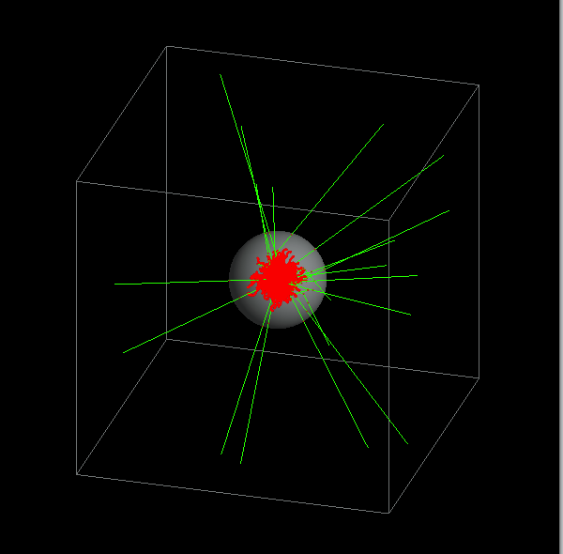
Simulation mediums
Dose point kernels algorithms are based on an idea of homogeneous medium
Human body is composed of different tissues: water, bone, blood, lung, adipose, red marrow …
ρ (g/cm³)
elemental composition (Z_{eff} )
Materials | bone | blood | lung | water | red marrow | adipose
Z­_{eff} | 11.87 | 7.78 | 7.74 | 7.42 | 7.21 | 6.47
ρ (g/cm³) | 1.85 | 1.06 | 0.26 | 1.00 | 1.03 | 0.92
We want to have the DPKs for various tissues to find whether it depends on tissue type.

Slide 7
Methodologies
Monoenergetic electron DPKs:
Beta spectrum DPKs:
Notes:
We define a spherical phantom with source at the center of the phantom. And we employed two slightly different formalism for the dose point kernels calculations.

Slide 8
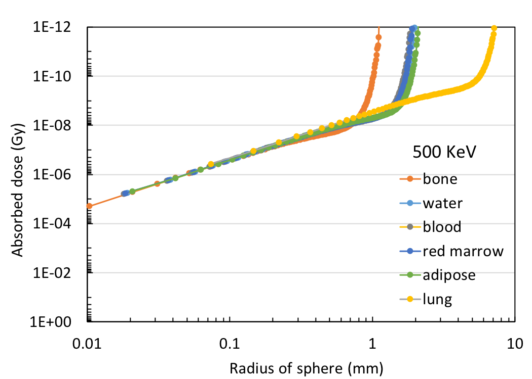
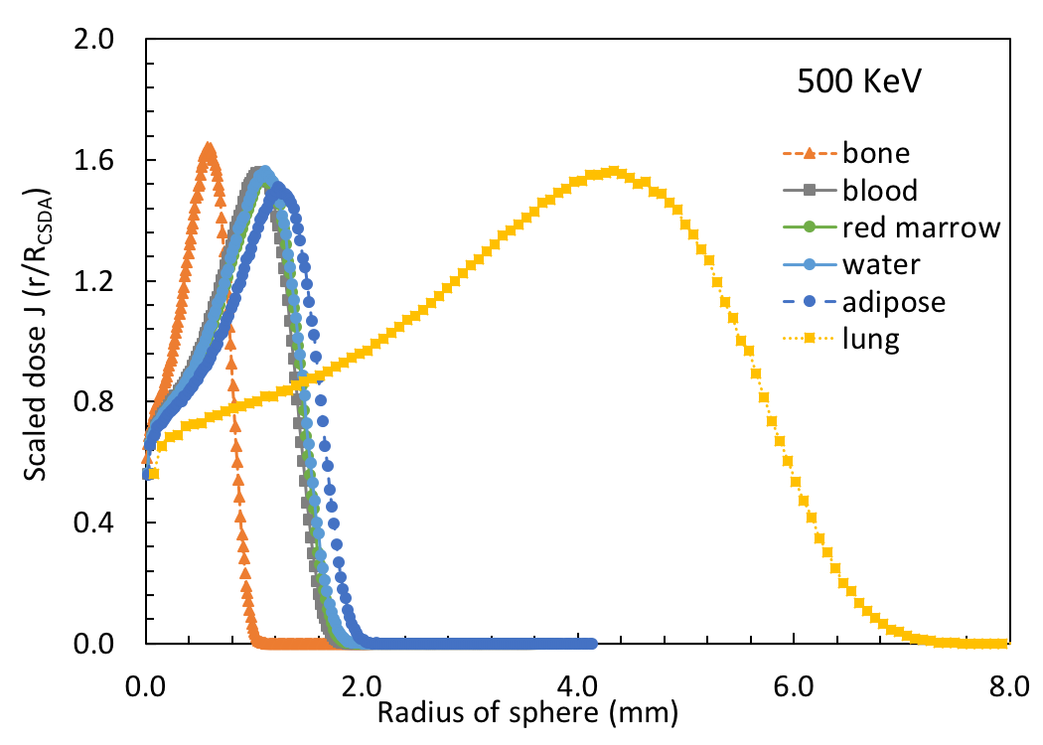
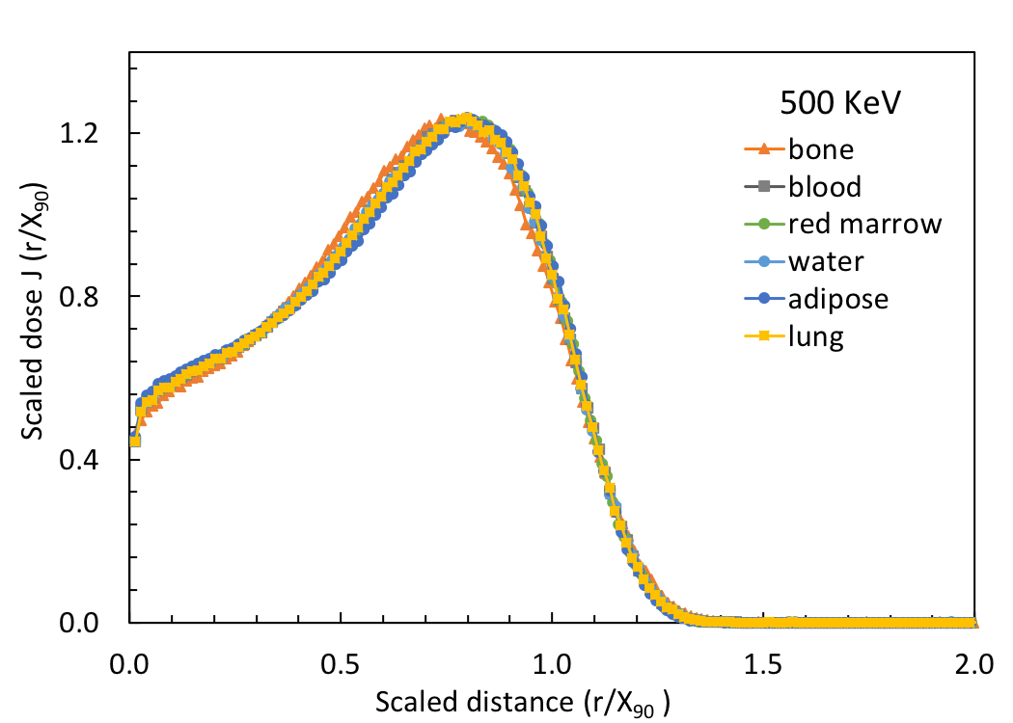
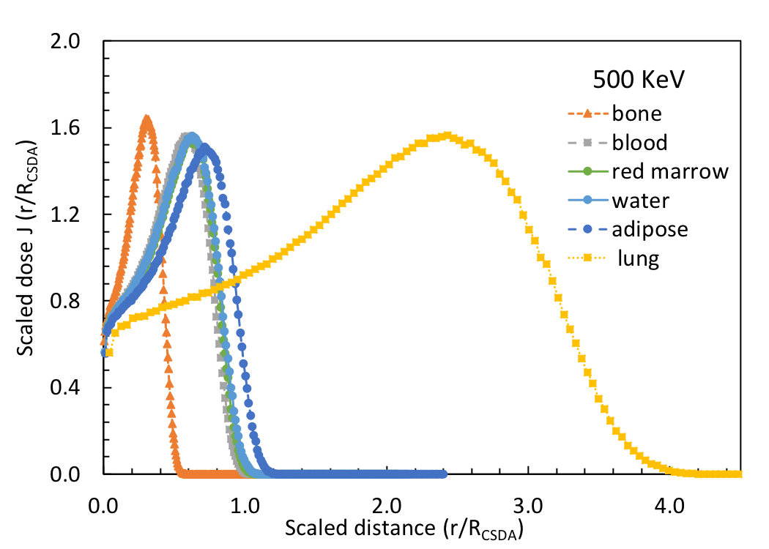
Results: (i) Monoenergetic electrons dose point kernels: 500 KeV
Notes:
Density of tissues are included in X90, and not included in Rcsda range.

Slide 9
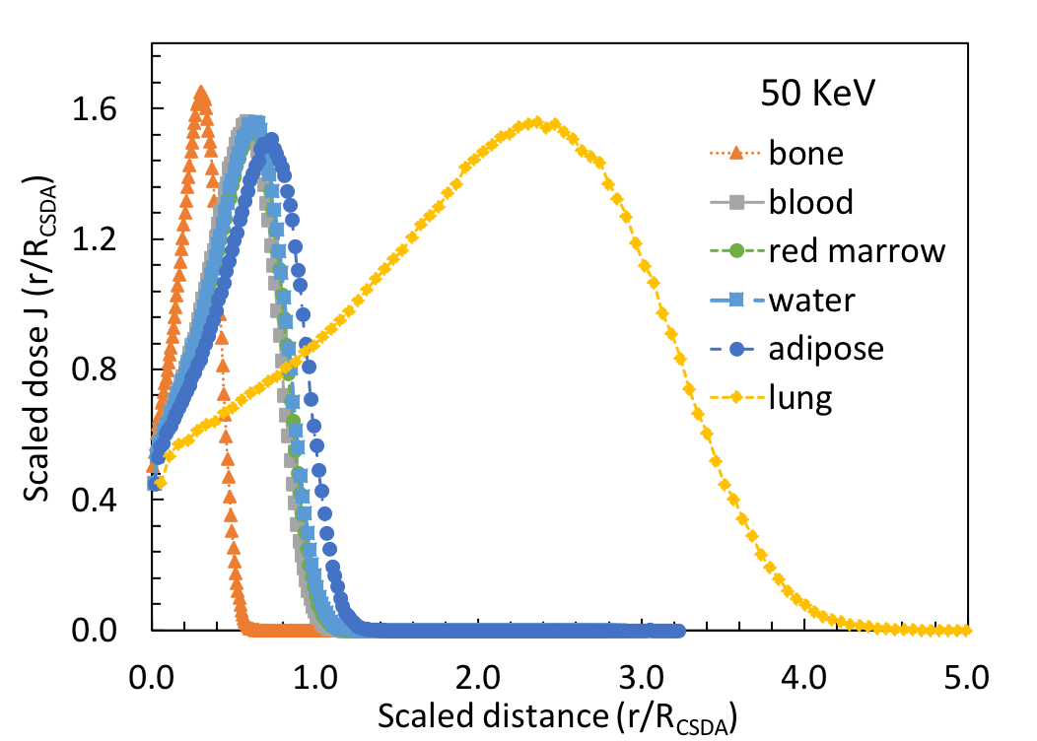
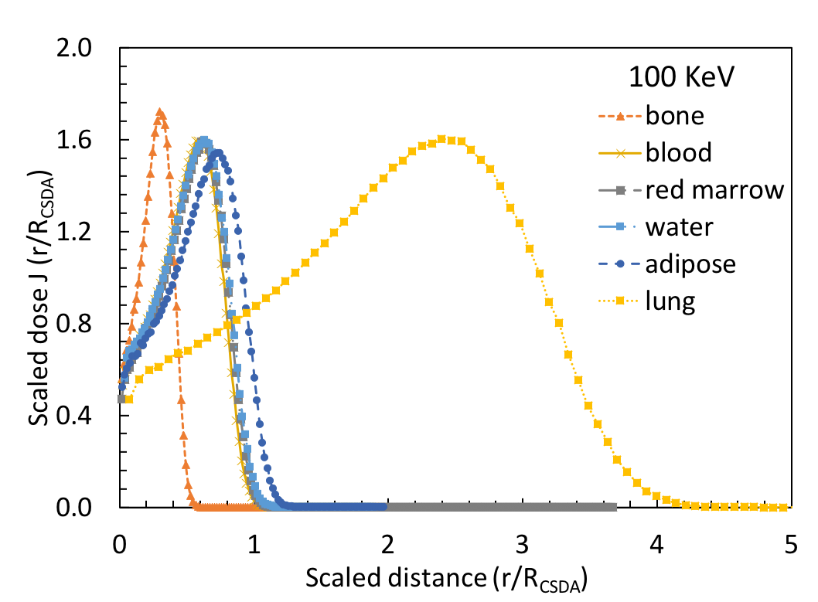
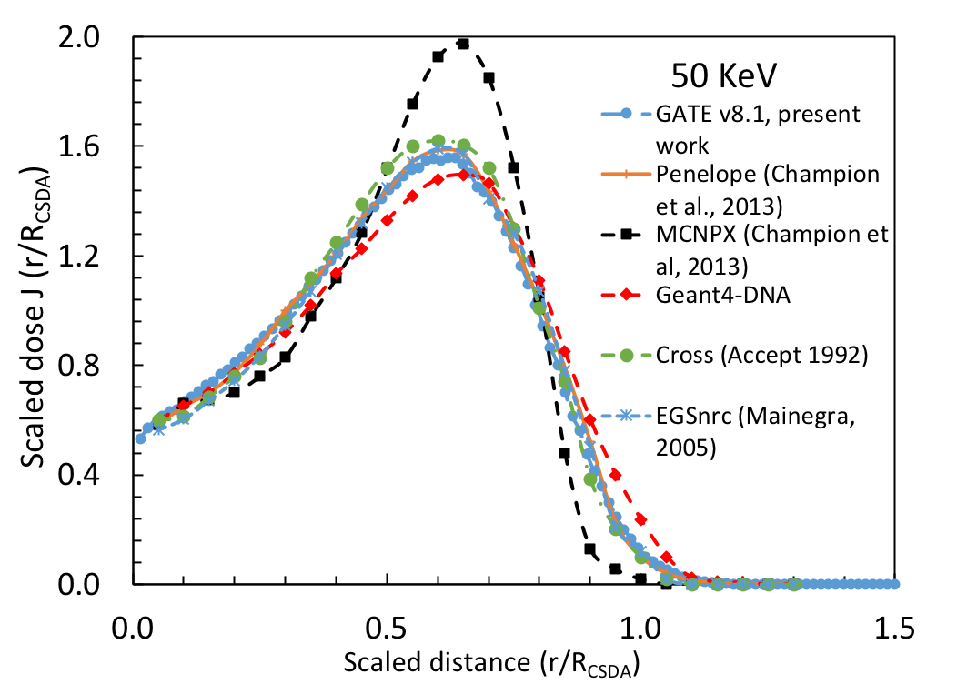
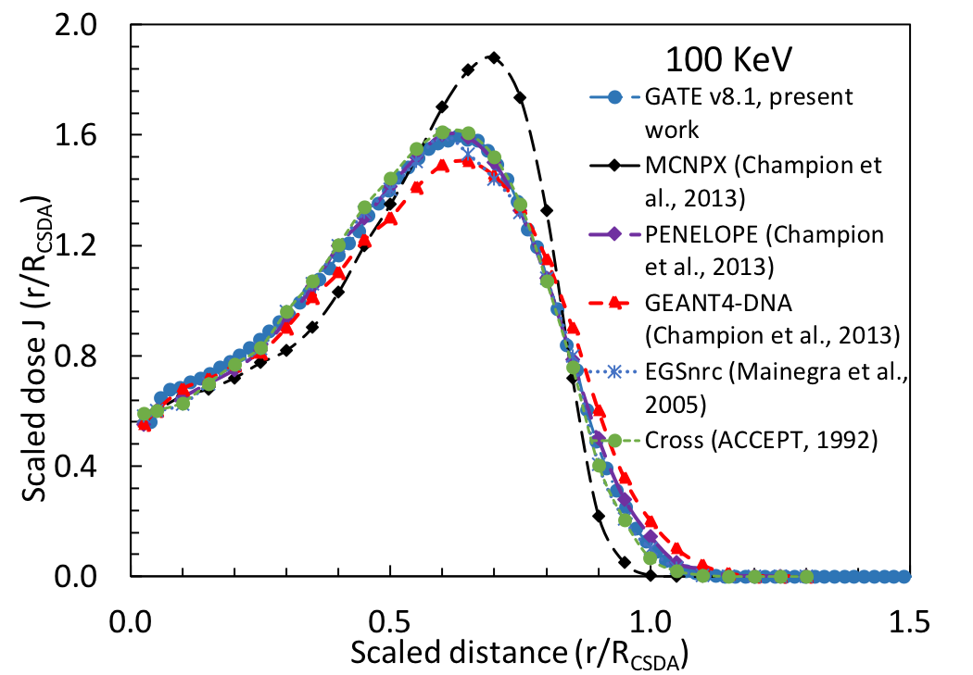
Comparison of monoenergetic electrons dose point kernels:

Slide 10
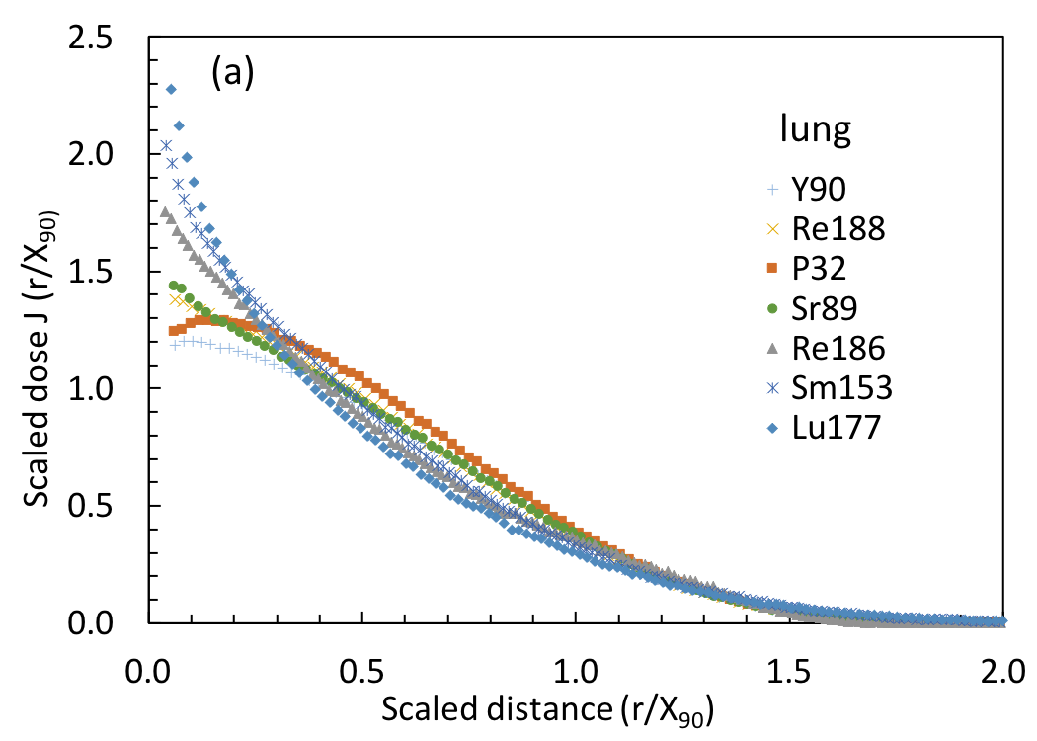
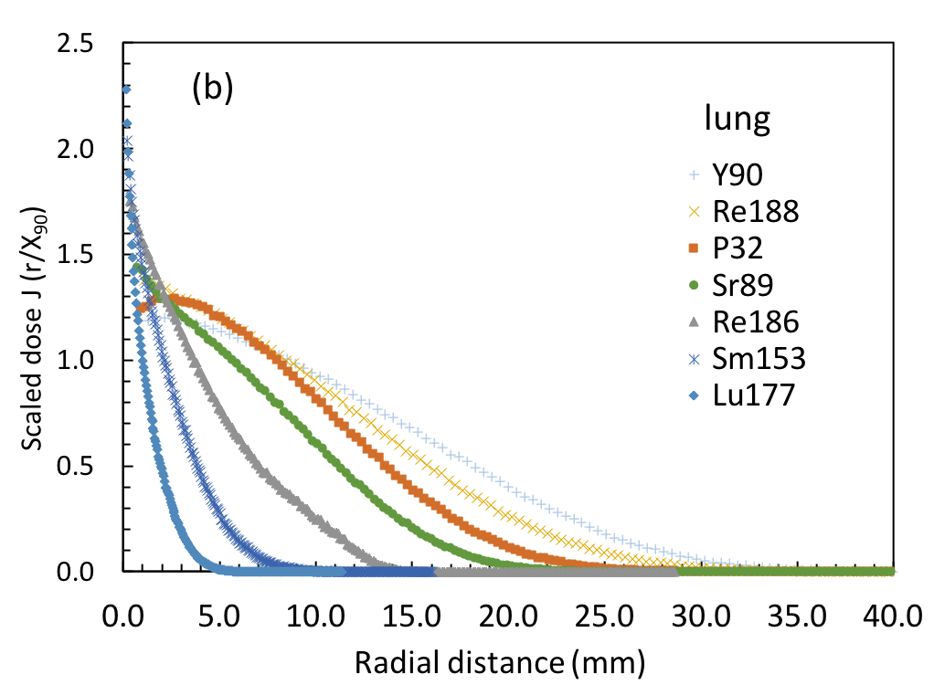
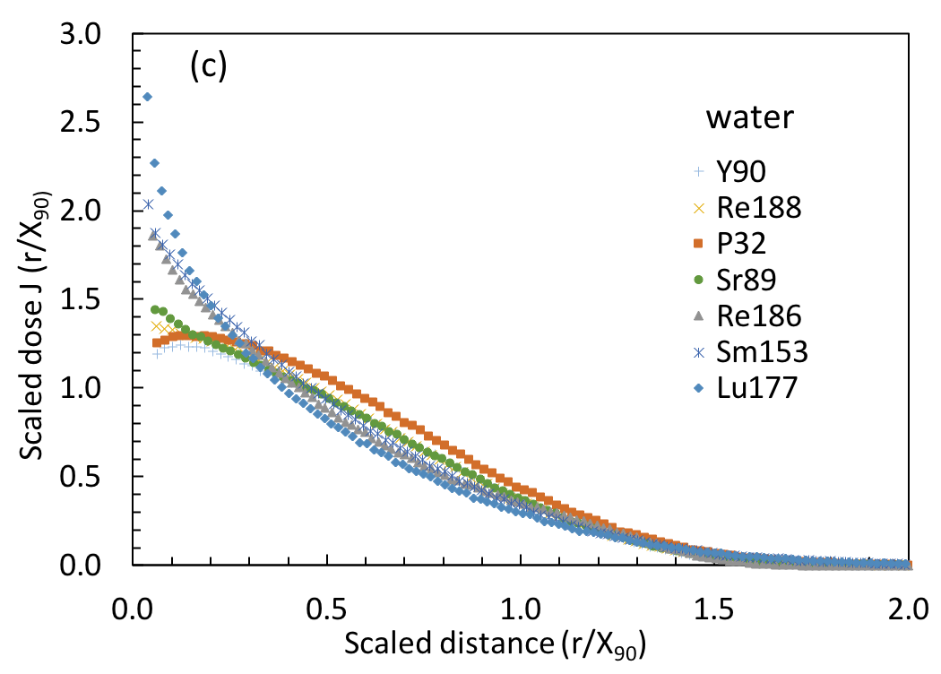
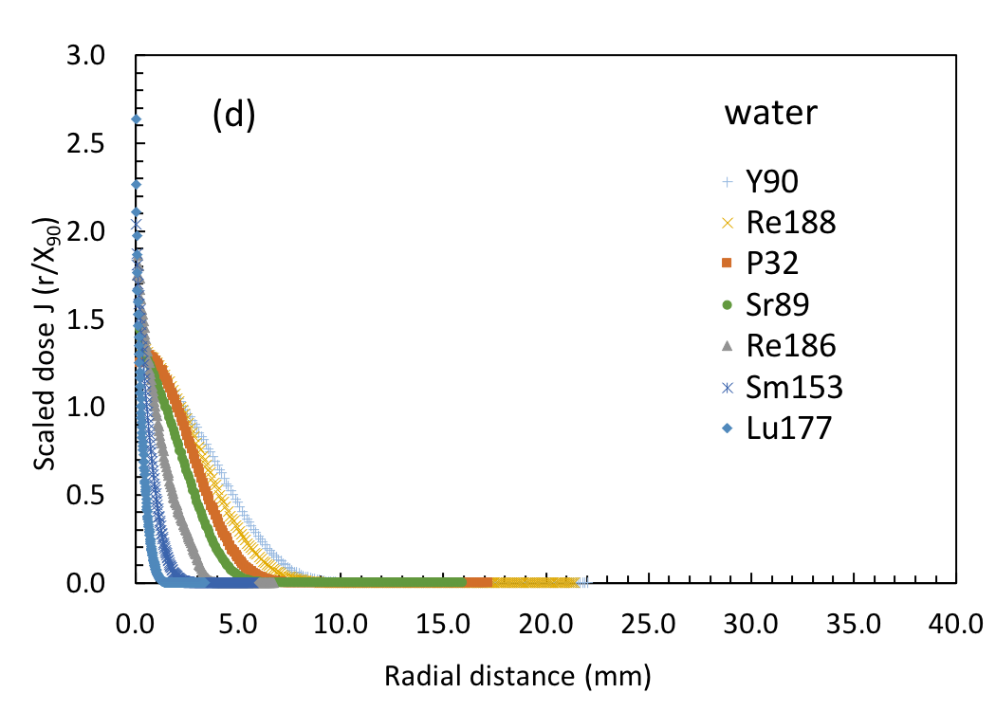
Results: (ii) beta radionuclides dose point kernels
Notes:
Dose point kernels are similar when scaled with X90 regardless of the tissue types.
Attenuation is greater in less dense tissues such as lung, however if we make a comparison with water then kernels are shrinked towards the origin as shown in figure (d).

Slide 11
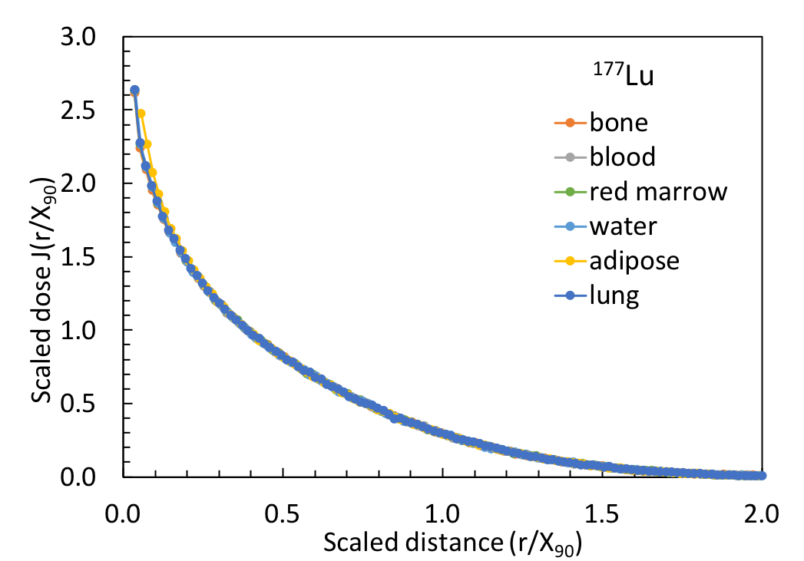
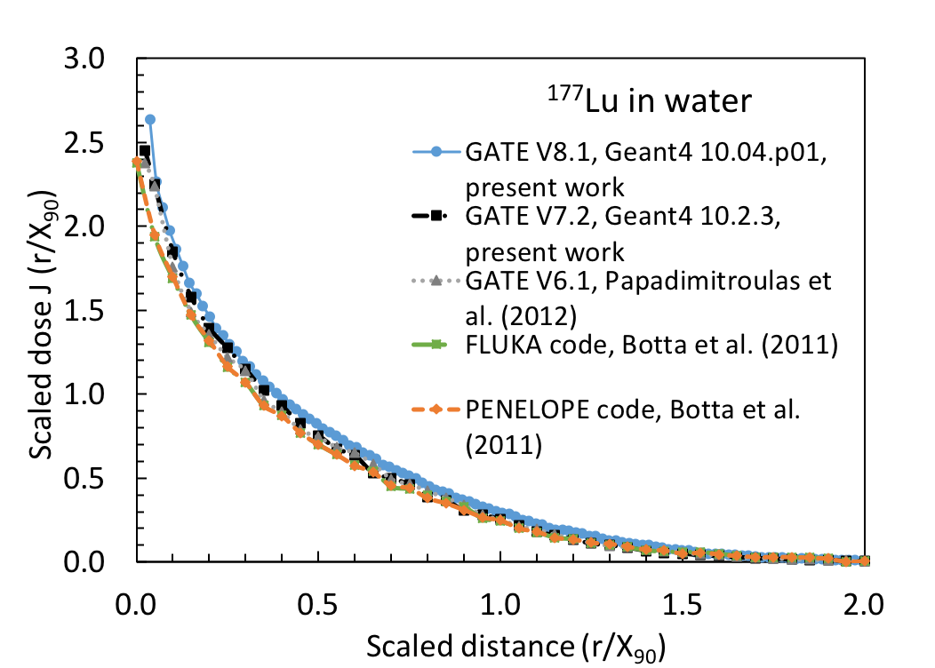
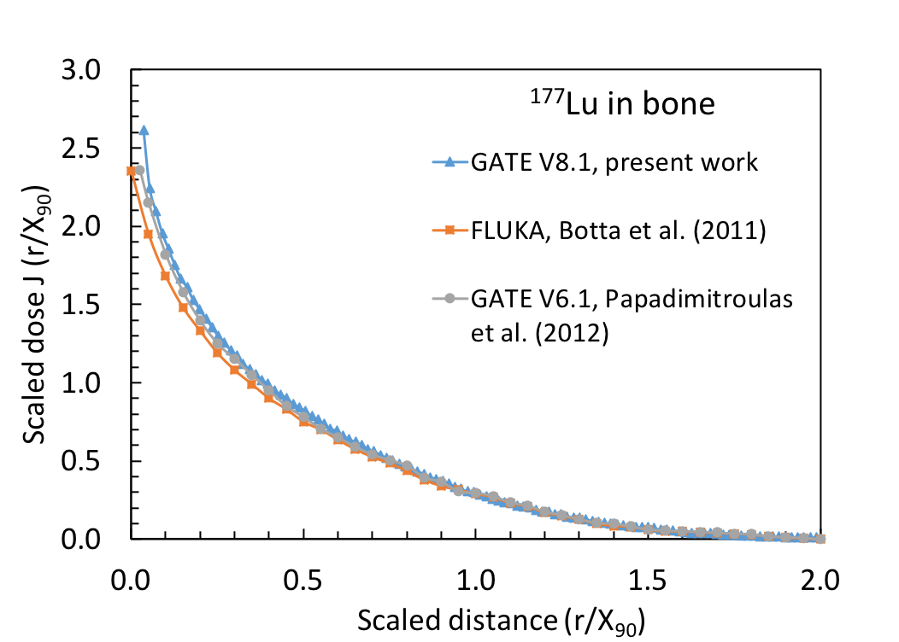
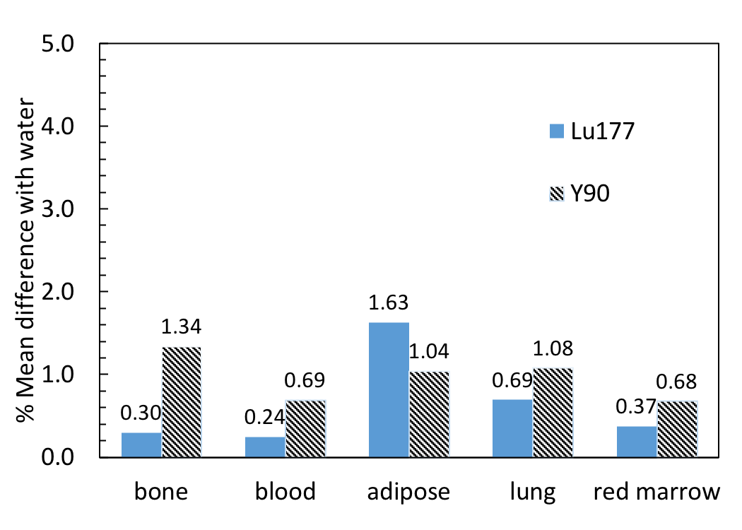
Impact of tissue type on dose point kernels?
Notes:
We compare the Lu177 in several tissue types.

Slide 12
Conclusion
Dose point kernels of monoenergetic electrons (0.015-10) MeV and radionuclides beta emitters has been simulated
Minimal discrepancies are observed between water and other tissues kernels when scaled with X₉₀ for all simulated isotopes
Impact of tissue type has been found to be minimal for purposes of dosimetry
Use of single kernel generated in water may be sufficient for 3D dose calculations
Future work is targeting experimental validation of dose point kernels

Slide 13
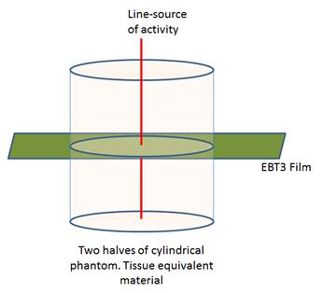
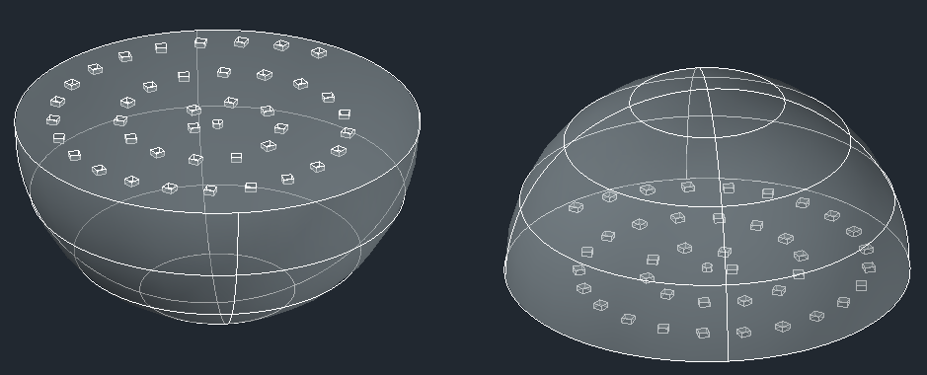
Experimental validation
TLD cavities
source
Fig 1: detector geometry with Gafchromic films
Fig 2: detector geometry equipped with TLDs

